Slide 1



Your Success
Is Our Business

Slide 2
Table Of Content
01
Welcome To Our Company
05
Our Products & Services
Who We Are
What We Do
02
Corporate Overview
06
Core Competencies
Our Team
Our Offerings
03
Differentiators
07
Past Performance
Why Us
Our Experience

Slide 3


Welcome To
Our Company
Your agency has a very important mission and you
deserve a partner who delivers outstanding products
and service every time.
Amalst is a woman and minority-owned small business committed to providing laboratory, medical and applied technology products to the federal government, state and
local municipalities.
www.amalst.com

Slide 4

Corporate Overview
Certifications
WOSB-SBA 241694
WBE-WBENC 2402592
Minority/Women-Owned Certified Small Business
Certified Capture Manager
Headquartered in Metro Atlanta
MBE GMSDC AT252142
Experienced Leadership Team
DBE GADOT
www.amalst.com
Celeste Keckley, CEO

Slide 5

Differentiators
25 Years Healthcare, Laboratory and Research Products and Services
Professional Laboratory Scientist - Infectious Disease
30,000 Product SKUs
Debt Free Business with Established Line Of Credit
www.amalst.com

Slide 6


Our Products
& Services
Medical and Laboratory Supplies, Equipment and Services
Explore our range of medical and laboratory supplies, equipment, and devices—from instruments and machines to specialized products for healthcare and research settings. Our professional services include equipment installation, calibration and validation, maintenance, repair and more.
Electronic Parts, Equipment and Industrial Supplies
Our electronic parts, professional equipment, and industrial supplies range from components and devices to tools and systems that support healthcare, laboratory, and industrial settings. Our services include sourcing, distribution, maintenance, and support to keep your operations running with precision and reliability.

Slide 7


Core
Competencies
Product Categories
Laboratory Supplies
Equipment and Furniture
Laboratory Equipment
Patient Care and Exam Room Supplies
Diagnostic Instruments
Protective Apparel
Diagnostic Test
Electronic Parts and Equipment
Home Health
Professional Equipment and Supplies
www.amalst.com
Infection Control
Industrial Supplies
amalst.com

Slide 8


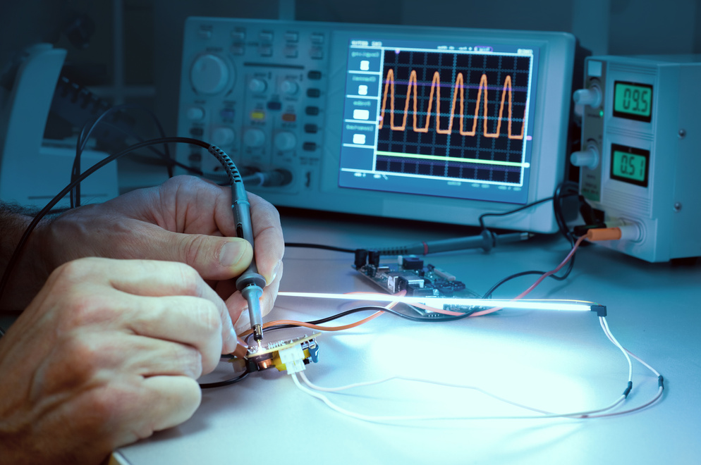
Core Competencies
MEDICAL PRODUCTS AND
EQUIPMENT
  423450 Medical, Dental & Hospital Equipment
  315250 Medical Service Apparel
  541715 Research and Development
LABORATORY PRODUCTS AND EQUIPMENT
  423490 Laboratory Equipment
  334516 Lab Analytical Instruments
  238390 Lab Furniture Equipment
ELECTRONIC PARTS, EQUIPMENT & INDUSTRIAL SUPPLIES
423690 Electronic Parts and Equipment
423490 Professional Equipment & Supplies
423840 Industrial Supplies Merchant Wholesalers Maintenance

Slide 9





Past Performance

Slide 10



Past Performance

Slide 11





Company Information
Amalst customer care specialist are ready to assist you. Let us know your needs. For support, information or questions choose from the following options.
www.amalst.com
Phone Number
+1 888.8(AMALST)
Thank you for exploring our offerings. Contact us today to learn more.
Email
info@amalst.com
Address
4555 Mansell Rd. Ste 300-11A Alpharetta, GA. 30022

Slide 12

Q & A
amalst.com

